Slide 1
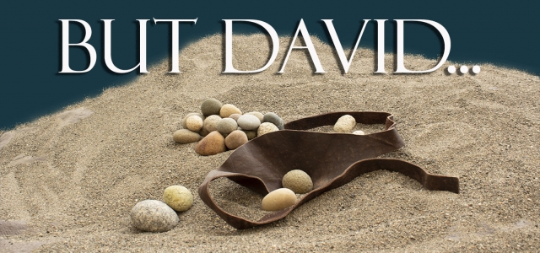

Slide 2
David’s Respect

Slide 3
Acts 13:36 “Now when David had served God's purpose in his own generation, he fell asleep;...”

Slide 4
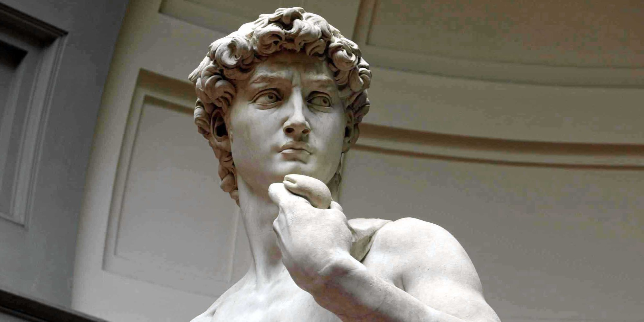
1- David’s Slingshot 2- David’s Respect 3- David’s Strength 4- David’s Sins 5- David’s Worship

Slide 5
[Video]

Slide 6
1 Samuel 26:1-17

Slide 7
1 Sam 18:5-8 “5 And David went out and was successful wherever Saul sent him, so that Saul set him over the men of war. And this was good in the sight of all the people and also in the sight of Saul’s servants. 6 As they were coming home, when David returned from striking down the Philistine, the women came out of all the cities of Israel, singing and dancing, to meet King Saul, with tambourines, with songs of joy, and with musical instruments. 7 And the women sang to one another as they celebrated, “Saul has struck down his thousands, and David his ten thousands.” 8 And Saul was very angry, and this saying displeased him. He said, “They have ascribed to David ten thousands, and to me they have ascribed thousands, and what more can he have but the kingdom?” 9 And Saul eyed David from that day on.”

Slide 8
John 2:23-24 (NLT) “23 Because of the miraculous signs Jesus did in Jerusalem at the Passover celebration, many began to trust in him. 24 But Jesus didn’t trust them, because he knew human nature.”

Slide 9
1 Samuel 21:10 -11 “10 That day David fled from Saul and went to Achish king of Gath. 11 But the servants of Achish said to him, “Isn’t this David, the king of the land? Isn’t he the one they sing about in their dances: “‘Saul has slain his thousands, and David his tens of thousands’?””

Slide 10
“9 But David said to Abishai, “Do not destroy him, for who can put out his hand against the LORD’s anointed and be guiltless?”

Slide 11
Deuteronomy 32:35 “35 Vengeance is mine, and recompense, for the time when their foot shall slip; for the day of their calamity is at hand, and their doom comes swiftly.”

Slide 12
Romans 13:1 “Let every person be subject to the governing authorities. For there is no authority except from God, and those that exist have been instituted by God.”

Slide 13
Don’t grab at what God has promised you.
If it’s worth anything it’s likely to be tested.
Jesus was given His inheritance after enduring a life of faithful patience, being overlooked, accused, misunderstood, and finally crucified.
Be careful how you justify your actions. Work within the context of a team.

